Slide 1

Quarter Review: Getting Ready for Assignment 1

Slide 2
What We’ll Be Talking About
Java Basics
Arrays
Loops
Conditionals

Slide 3
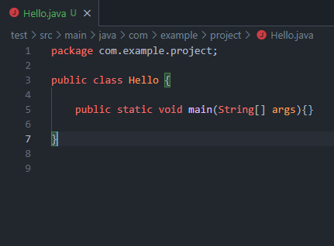
The Main Method: Anatomy
public - access modifier
static - non-access modifier
void - return type
main - method name
String[ ] - the expected argument
args - name of the argument

Slide 4
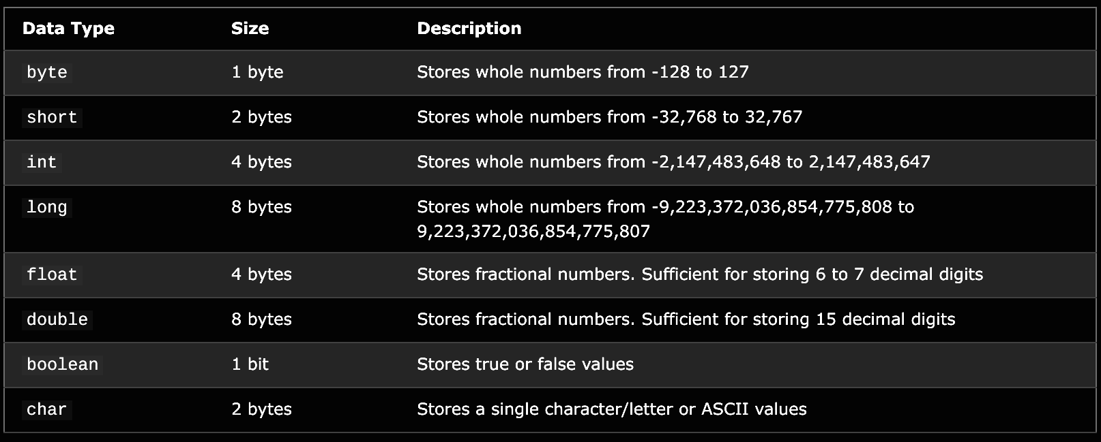
Primitive Data Types

Slide 5
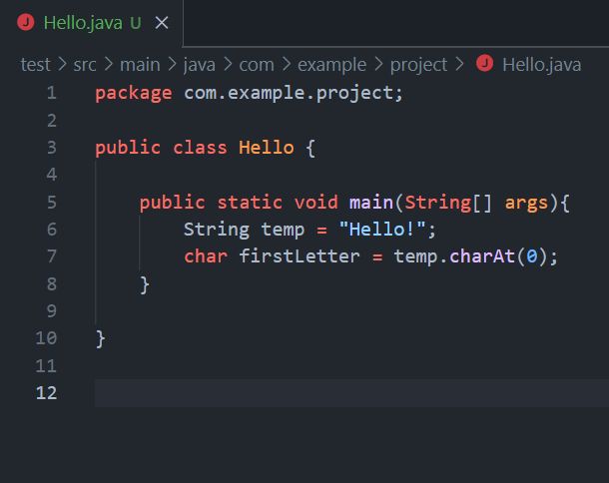
Non-Primitive Data Types
Strings - arrays of chars.

Slide 6
Non-Primitive Data Types
Strings - arrays of chars.
Or similar to that. Technically it is a custom data type that has all the functionality necessary to perform String operations

Slide 7
Non-Primitive Data Types
Strings - arrays of chars.
Or similar to that. Technically it is a custom data type that has all the functionality necessary to perform String operations
Arrays - arrays can be treated as a data type.

Slide 8
Non-Primitive Data Types
Strings - arrays of chars.
Or similar to that. Technically it is a custom data type that has all the functionality necessary to perform String operations
Arrays - arrays can be treated as a data type.
Classes / Custom Data Types - later in the class we will learn to create our own custom data types.

Slide 9
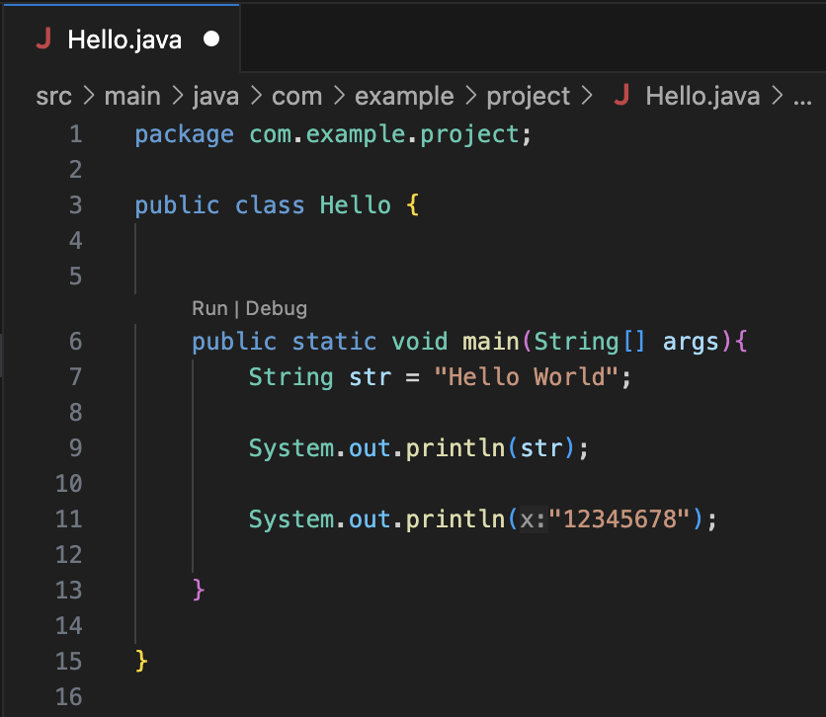
Data Type Literals
With each of these data types comes the ability to declare them literally in Java.
For Example:
“string” is a String literal
2 would be an int literal
2.0 would be a double literal
true would be a Boolean literal

Slide 10
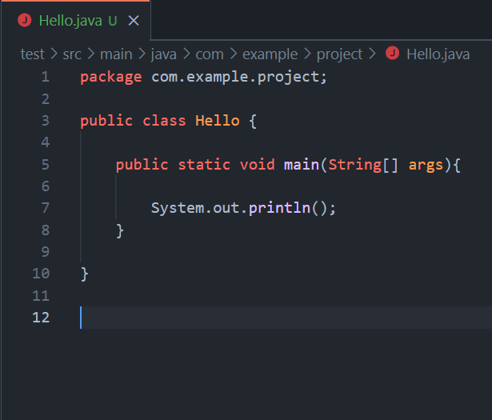
System Class
Among the facilities provided by the System class are standard input, standard output, and error output streams.

Slide 11
System Class
Among the facilities provided by the System class are standard input, standard output, and error output streams.
System.out - a subclass of System with many tools including print() and println().

Slide 12
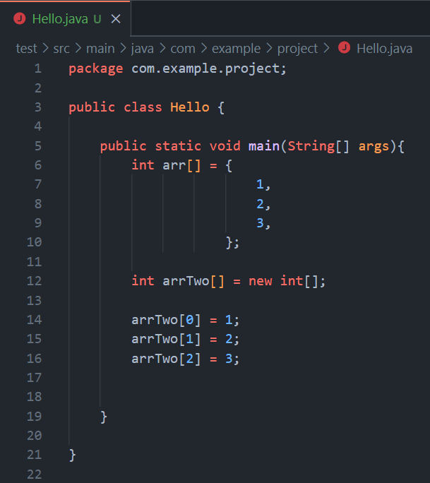
Arrays
Can be made in two ways.

Slide 13
Arrays
Can be made in two ways.
Can hold any primitive data type and in many cases non-primitive data types.

Slide 14
Arrays
Can be made in two ways.
Can hold any primitive data type and in many cases non-primitive data types.
Uses zero-indexing.

Slide 15
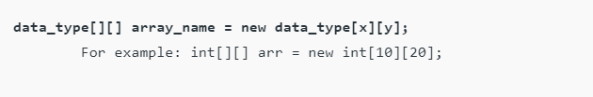
Indirect Method of Declaration
Declaration – Syntax:

Slide 16
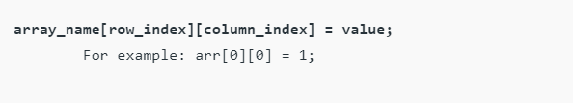
Indirect Method of Declaration
Declaration – Syntax:
Initialization – Syntax:

Slide 17
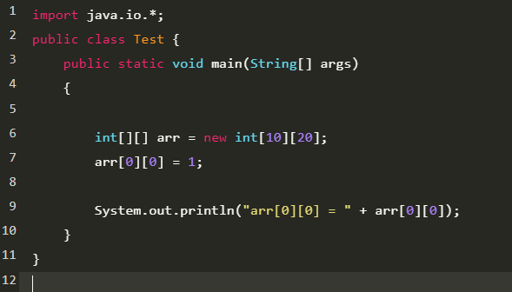
output: arr[0][0] = 1

Slide 18
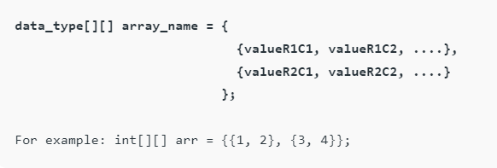
Direct Method of Declaration
Declaration and Initialization:

Slide 19
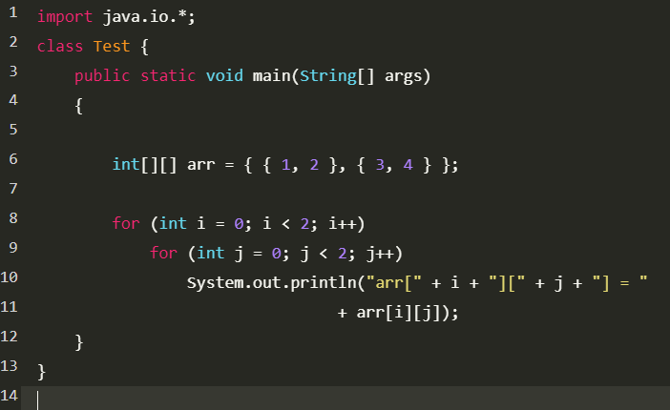
output:
arr[0][0] = 1
arr[0][1] = 2
arr[1][0] = 3
arr[1][1] = 4

Slide 20
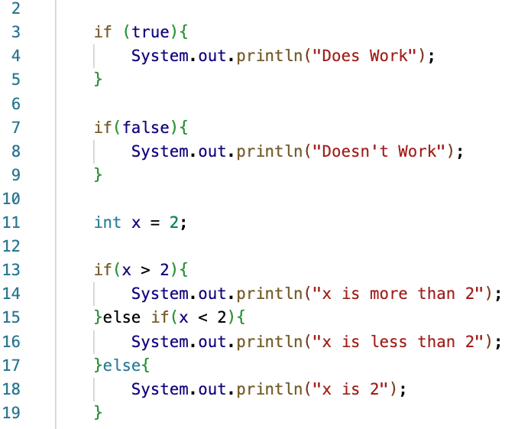
Most Basic Conditional
The most basic conditionals in Java are the “if”, “else”, and “else if” statements.
Each of them act on some expression surrounded by parentheses which resolves to some Boolean value.

Slide 21
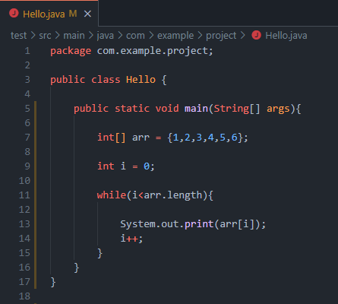
While Loops
Simplest Form of Loop.

Slide 22
While Loops
Simplest Form of Loop.
Primarily useful when looping on a trigger instead of a count.

Slide 23
While Loops
Simplest Form of Loop.
Primarily useful when looping on a trigger instead of a count.
Should be controlled but will not throw an error when it goes infinite.

Slide 24
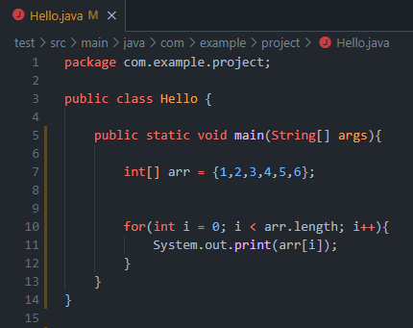
For Loops
A more refined, count based Loop.

Slide 25
For Loops
A more refined, count based Loop.
Good for keeping track of loop iteration while running.

Slide 26
For Loops
A more refined, count based Loop.
Good for keeping track of loop iteration while running.
Is just a combination of the same fundamental parts we used in the While Loop example.

Slide 27
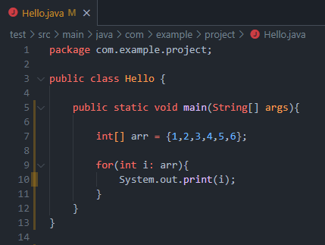
For Each Loops
A more refined, modern, and simple loop.

Slide 28
For Each Loops
A more refined, modern, and simple loop.
Good for a more simple coverage loop.

Slide 29
For Each Loops
A more refined, modern, and simple loop.
Good for a more simple coverage loop.
Can handle scaling well and can be easily made generic in order to handle all sorts of types.

Slide 30
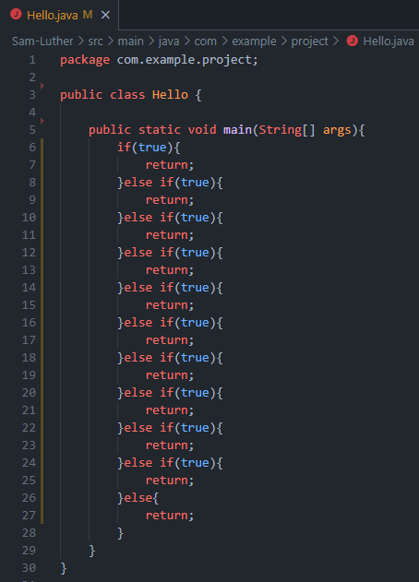
Switch Statements
Are a way of avoiding huge if-else blocks which can be hard to read and maintain.
As with many things in Java switch statements are not required for the compiler or for some specific use case.
They are simply used to help the human interacting with your program.

Slide 31
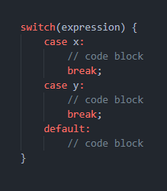
Basic Syntax

Slide 32
Basic Syntax
Expression - refers to the thing you will be switching on. This could be a variable or even an operation on a variable. Eg: i%2.
Case - is more or less going to take a potential or desired output from the expression in your switch. Can be treated as an if-true type statement.
Default - this code is only executed if no other cases fit the output of the expression.

Slide 33
Basic Syntax
Expression - refers to the thing you will be switching on. This could be a variable or even an operation on a variable. Eg: i%2.
Case - is more or less going to take a potential or desired output from the expression in your switch. Can be treated as an if-true type statement.
Default - this code is only executed if no other cases fit the output of the expression.

Slide 34
Basic Syntax
Expression - refers to the thing you will be switching on. This could be a variable or even an operation on a variable. Eg: i%2.
Case - is more or less going to take a potential or desired output from the expression in your switch. Can be treated as an if-true type statement.
Default - this code is only executed if no other cases fit the output of the expression.

Slide 35
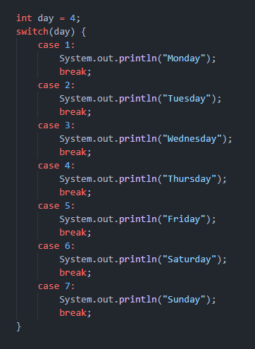

Slide 36
The break Keyword
When Java reaches a break keyword, it breaks out of the switch block.

Slide 37
The break Keyword
When Java reaches a break keyword, it breaks out of the switch block.
This will stop the execution of more code and case testing inside the block.

Slide 38
The break Keyword
When a match is found, and the job is done, it's time for a break. There is no need for more testing.

Slide 39
The break Keyword
When a match is found, and the job is done, it's time for a break. There is no need for more testing.
A break can save a lot of execution time because it "ignores" the execution of all the rest of the code in the switch block.

Slide 40
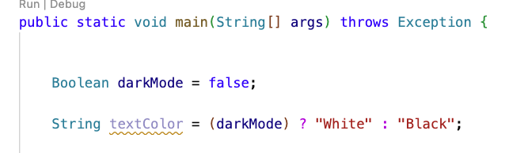
Conditional Operators
Significantly less common in java than any other conditionals.
Used pretty often in languages other than Java.
A shorthand conditional in an expression format.
Can be quite stylish but often frowned upon.

Slide 41
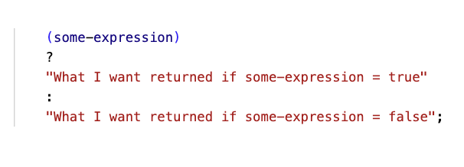
Conditional Operators
Conditional Operators are technically ternary operators (acting on three operands).
The i++ expression would be a unary operator (acting upon one operand), i + 1 would be a binary operator (acting upon two operands).

Slide 42
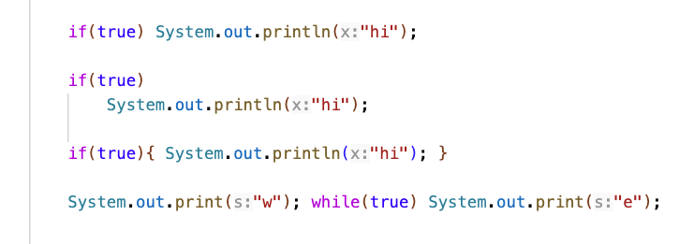
A Java Structural Shortcut
If a structure using curly braces in java would only enclose one line of code, you can omit the curly braces.

Slide 43

Let's hop in live share

Slide 44
Closing
Office Hours In SS-411:
Tu & Th 2pm – 3pm
Mon & Wed 10am–11am
Have a great weekend and I’ll see you on Monday!

